Slide 1
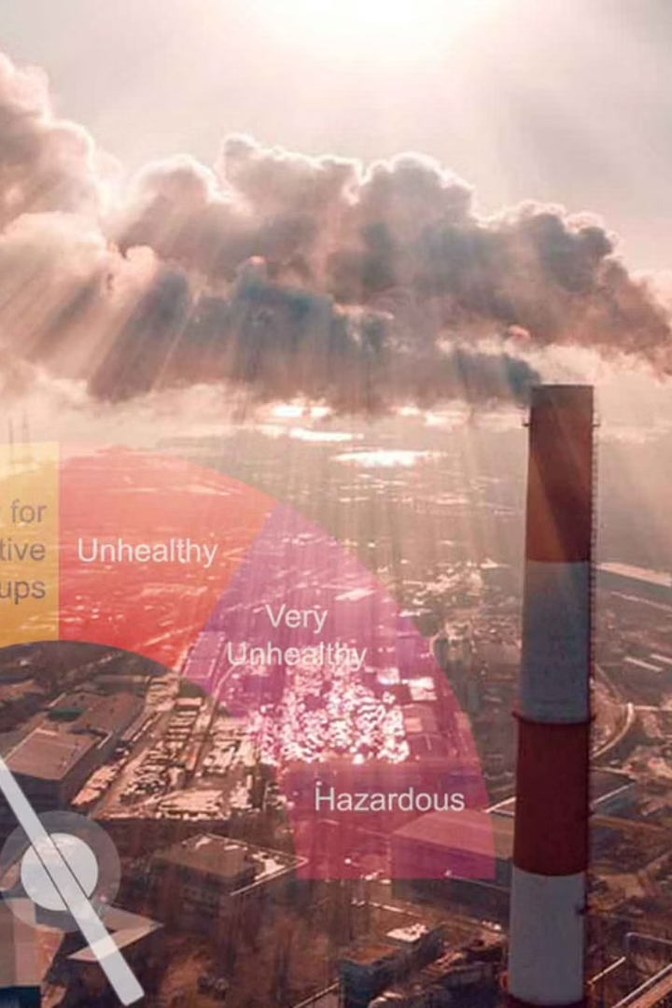
AQI Prediction: Machine Learning Approach
Discover how machine learning is revolutionizing air quality monitoring. This presentation explores the use of advanced algorithms to predict Air Quality Index (AQI) and mitigate environmental health risks. Learn how technology can help save lives and improve global health.

Slide 2
The Air Quality Crisis
Silent Killer
Modern Activities
Global air pollution poses a significant threat to human health. It acts as a "silent killer" with insidious impacts.
Continuous hazardous pollutants are generated daily. These pollutants stem from industrial, transport, and domestic activities.
Air quality is directly harmed by these ongoing activities. This crisis demands innovative solutions for environmental protection.

Slide 3
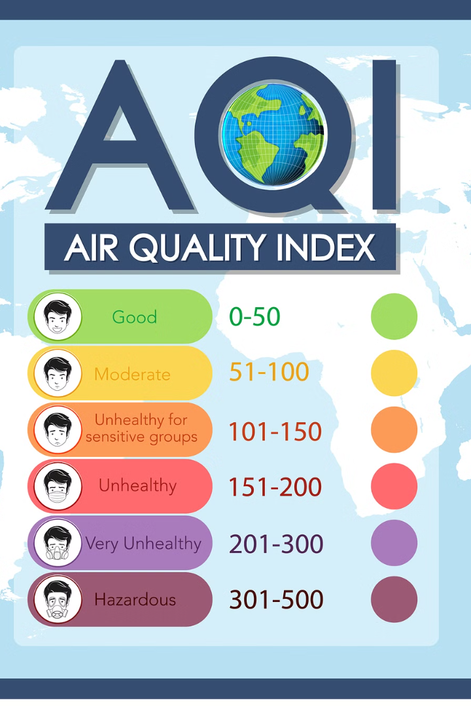



Understanding Air Quality Index (AQI)
Reporting Air Quality
Educating the Public
AQI reports on the impacts of pollution on human health.
It educates the public about the negative effects of air pollution.
Key Pollutants
It typically covers six key pollutants, including Ozone, Carbon Monoxide, and Particulate Matter.

Slide 4
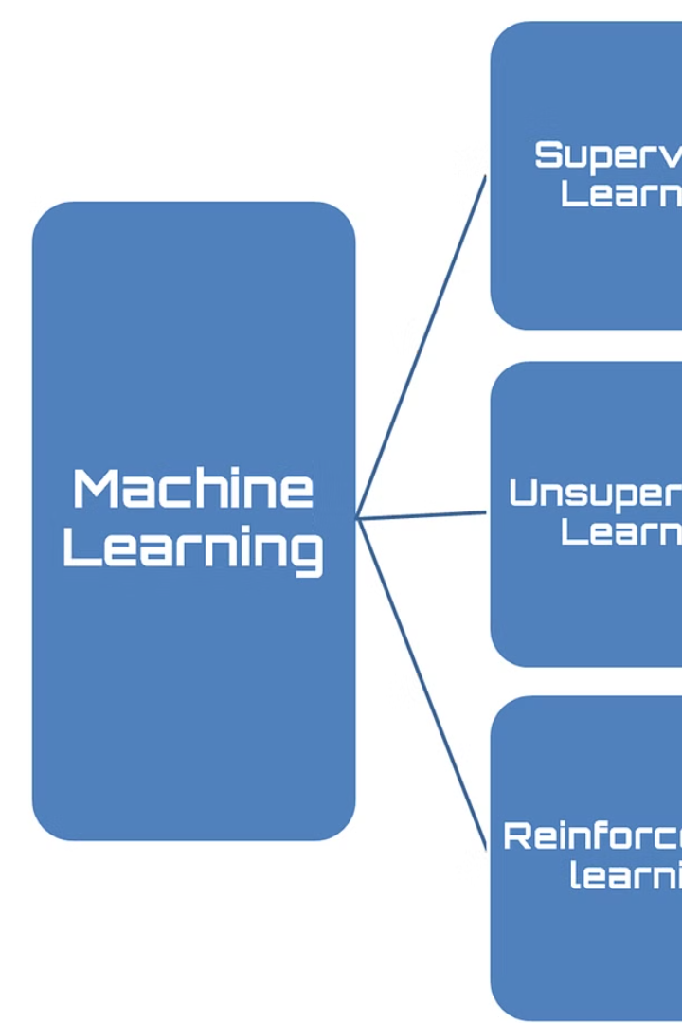



Why Machine Learning for AQI Prediction?
Efficient Tool
Harness Technology
Real-Time Alerts
Machine learning is the most efficient tool to study environmental hazards. It can save millions of lives globally by providing real-time air quality alerts.

Slide 5



Machine Learning Techniques
Logistic Regression
2
For binary classification problems.
Random Forest
1
An ensemble learning method.
Adaptive Boosting
3
Combines multiple weak learners.
Advanced machine learning algorithms are used for AQI prediction. These include Random Forest, Logistic Regression, and Adaptive Boosting (AdaBoost).

Slide 6


Prediction Accuracy Benchmarks
99.90%
87.71%
Random Forest accuracy
Logistic Regression
93.75%
Adaptive Boosting accuracy
These algorithms demonstrate high accuracy in AQI prediction. Random Forest achieves 99.90% accuracy, while Adaptive Boosting reaches 93.75% and Logistic Regression reaches 87.71%.

Slide 7
Real-World Applications
Traffic Routing
1
Improves route efficiency.
Pollutant Identification
2
Pinpoints dangerous substances.
Health Benefits
3
Prevents premature deaths.
Practical benefits include improved traffic routing and identifying serious pollutants. This prevents premature deaths and reduces chronic diseases.

Slide 8
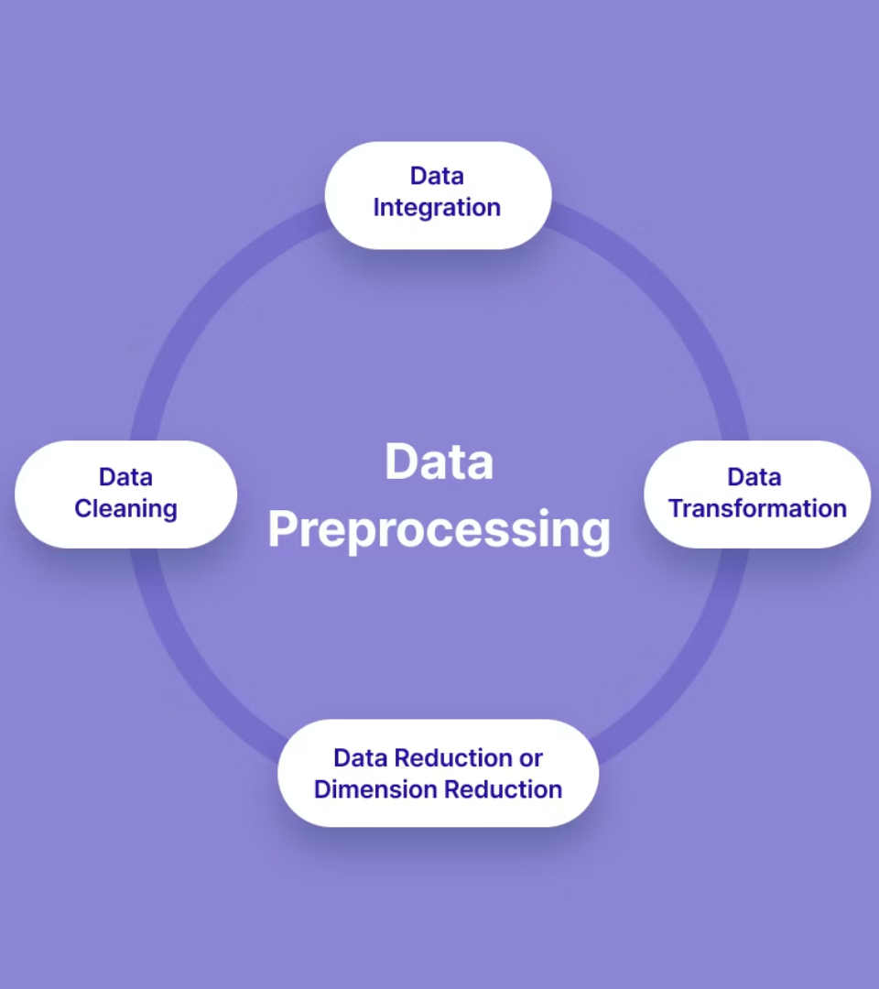



Data Preprocessing Challenges
Datasets
Preprocessing datasets
Feature selection
Through correlation analysis
Data analysis
Exploratory data analysis
Key steps involve feature selection and exploratory data analysis. Resampling techniques address data imbalance, improving model evaluation.

Slide 9



Future Research Directions
1
Satellite Imagery
2
Extensive Data
3
Advanced AI
Emerging opportunities include integrating satellite imagery. Collaborative approaches are needed involving governments, NGOs, and corporations.

Slide 10

Conclusion: Protecting Our Future
Unprecedented Potential
Save Lives
AQI prediction saves lives and improves global health.
Machine learning offers opportunities for environmental monitoring.
Continuous Innovation
Key to addressing air quality challenges.
Continuous innovation is key to addressing air quality challenges. Machine learning helps save lives and improve global health.

Slide 11
Made By:
Girish Kumar Yadav
CS-2341412 , 2CSE4
Garvit Jain
CS-2341321 , 2CSE13
Veer Singhi
CS-2341376 , 2CSE13

